Slide 1
PHP Framework for Inventory Management System for UCSC
by D.M.G.N.Dissanayake
Supervised by : Dr. Ajantha Athukorale

Slide 2
Scope & Key Objectives
Creating an innovative application to be initiated in UCSC, suitable to be customized for any public sector organization’s supplies division in Sri Lanka
Reduce
documentation,
paper wastage,
manpower,
related to inventory management activities in public sector.

Slide 3
Case Study Approach
where
why
when
?
who
how
what

Slide 4
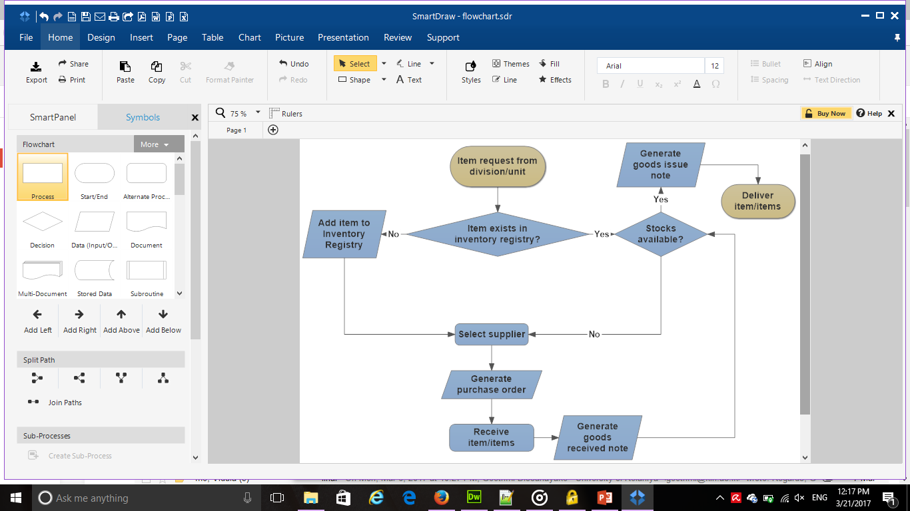
Data Flow

Slide 5
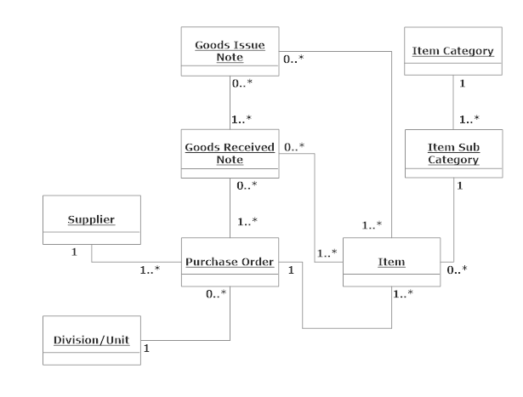
Conceptual Model

Slide 6

Prototype & Application
Technology
Programming language : PHP, JavaScript
DBMS : MySQL
Reporting : PDF
Type : Web Based
The Client
Senior Assistant Bursar, Supplies Division ,UCSC

Slide 7
Testing example :login UI
 | Test data | Purpose | Expected result
1. | Enter a wrong username | Test username | Display error message. User not logged in.
2. | Enter a wrong password | Test password | Display error message. User not logged in.
3. | Click login button with empty username | Test login without an account | Display error message. User not logged in.
4. | Click login button with empty password | Test login without a password | Display error message. User not logged in.
5. | Enter correct username and password | Test correct login to system | User logged in.

Slide 8
Testing example :fund UI
 | Test data | Purpose | Expected result
1. | Enter an invalid/empty amount | Test saving fund with invalid amount | Display error message. Funds not added.
2. | Click save button without selecting year | Test year field | Display error message. Funds not added.
3. | Click save button without selecting grant | Test year | Display error message. Funds not added.
4. | Click save button after selecting year, grant and inserting valid amount | Test correct funds addition | Funds added.

Slide 9
Conclusion
A web based Inventory Management System has a huge impact on speed & efficiency of Inventory Management process.
It can make the tasks of the supplies staff more easier.
The system can be expanded into a fully automated supply chain management system, with advanced features.

Slide 10
THANK YOU

